Slide 1
Meeting Agenda
November 12,2024

Slide 2
Agenda
Funding for next year
Tuition waiver for grad school
PHD?
Results
Next Steps

Slide 3
Results

Slide 4
Explanatory = illness

Slide 5
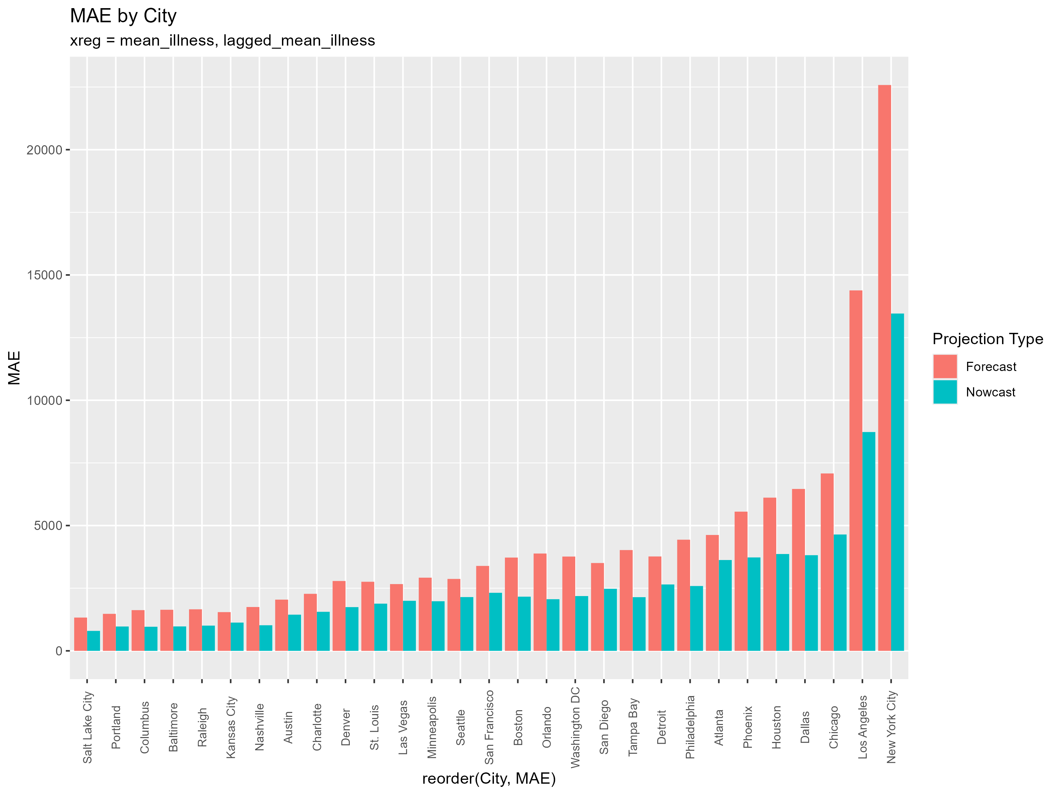

Slide 6
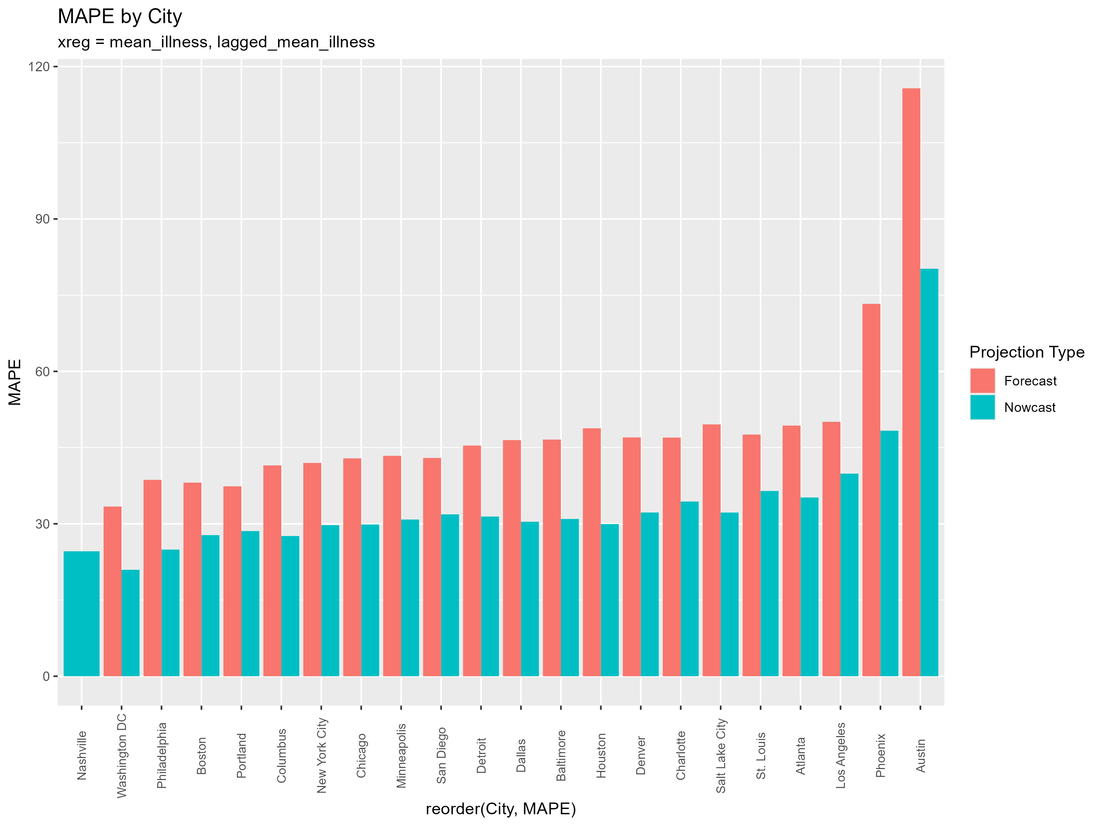

Slide 7
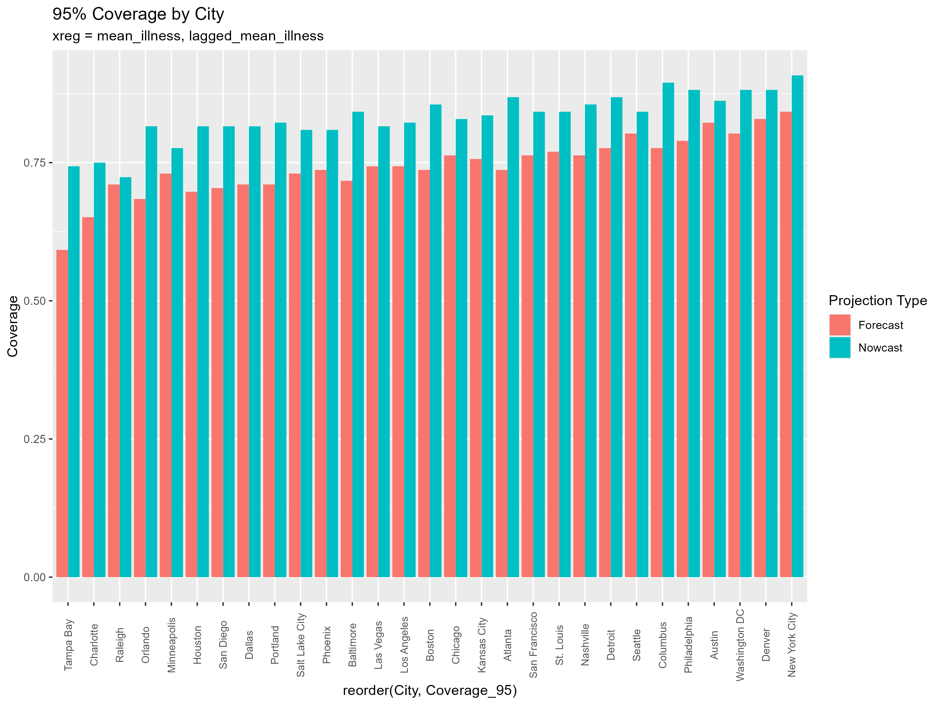

Slide 8
Explanatory = health

Slide 9


Slide 10
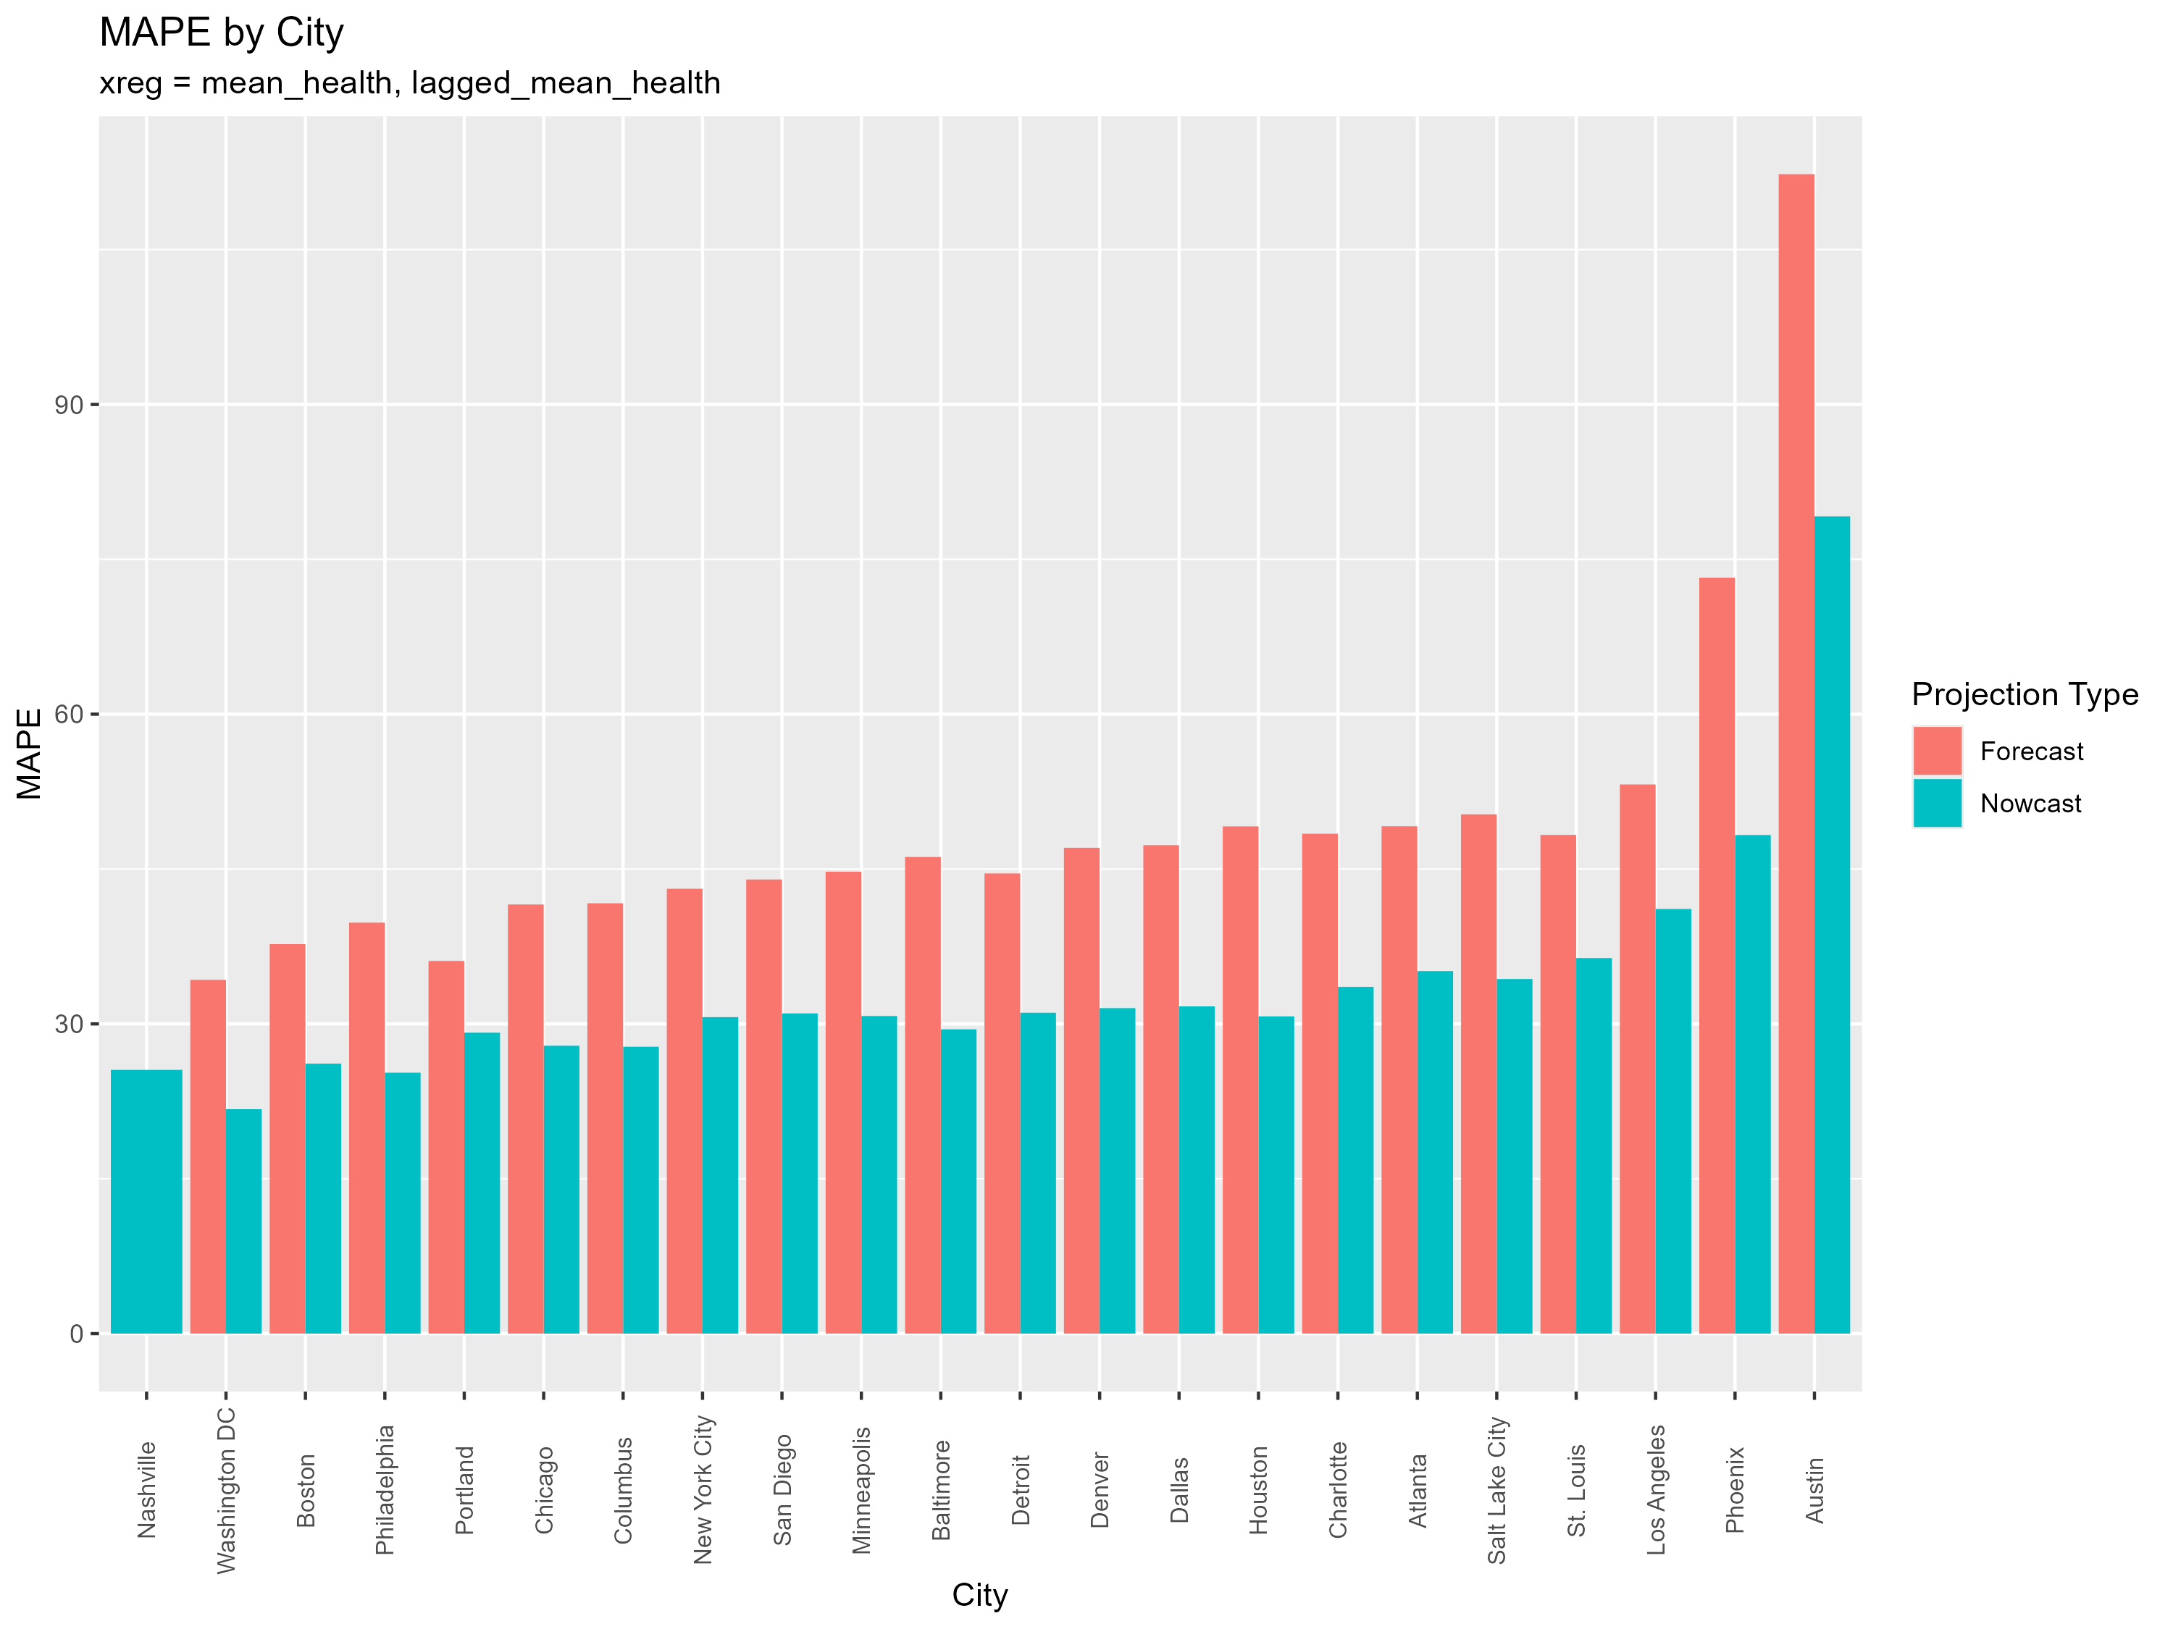

Slide 11
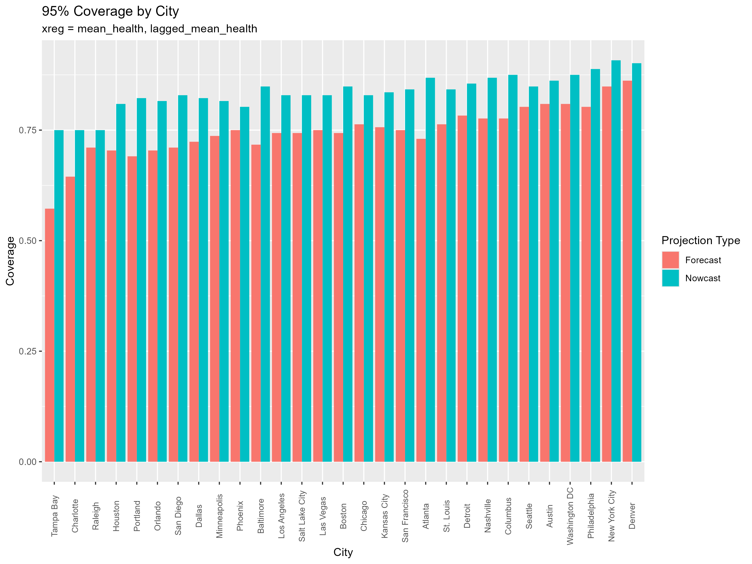

Slide 12
Explanatory = Affect

Slide 13


Slide 14
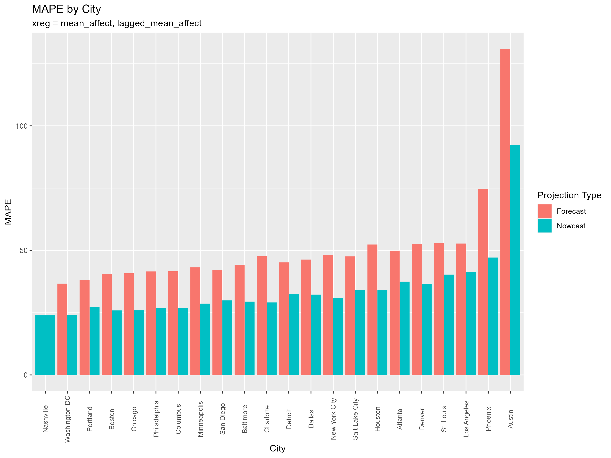

Slide 15
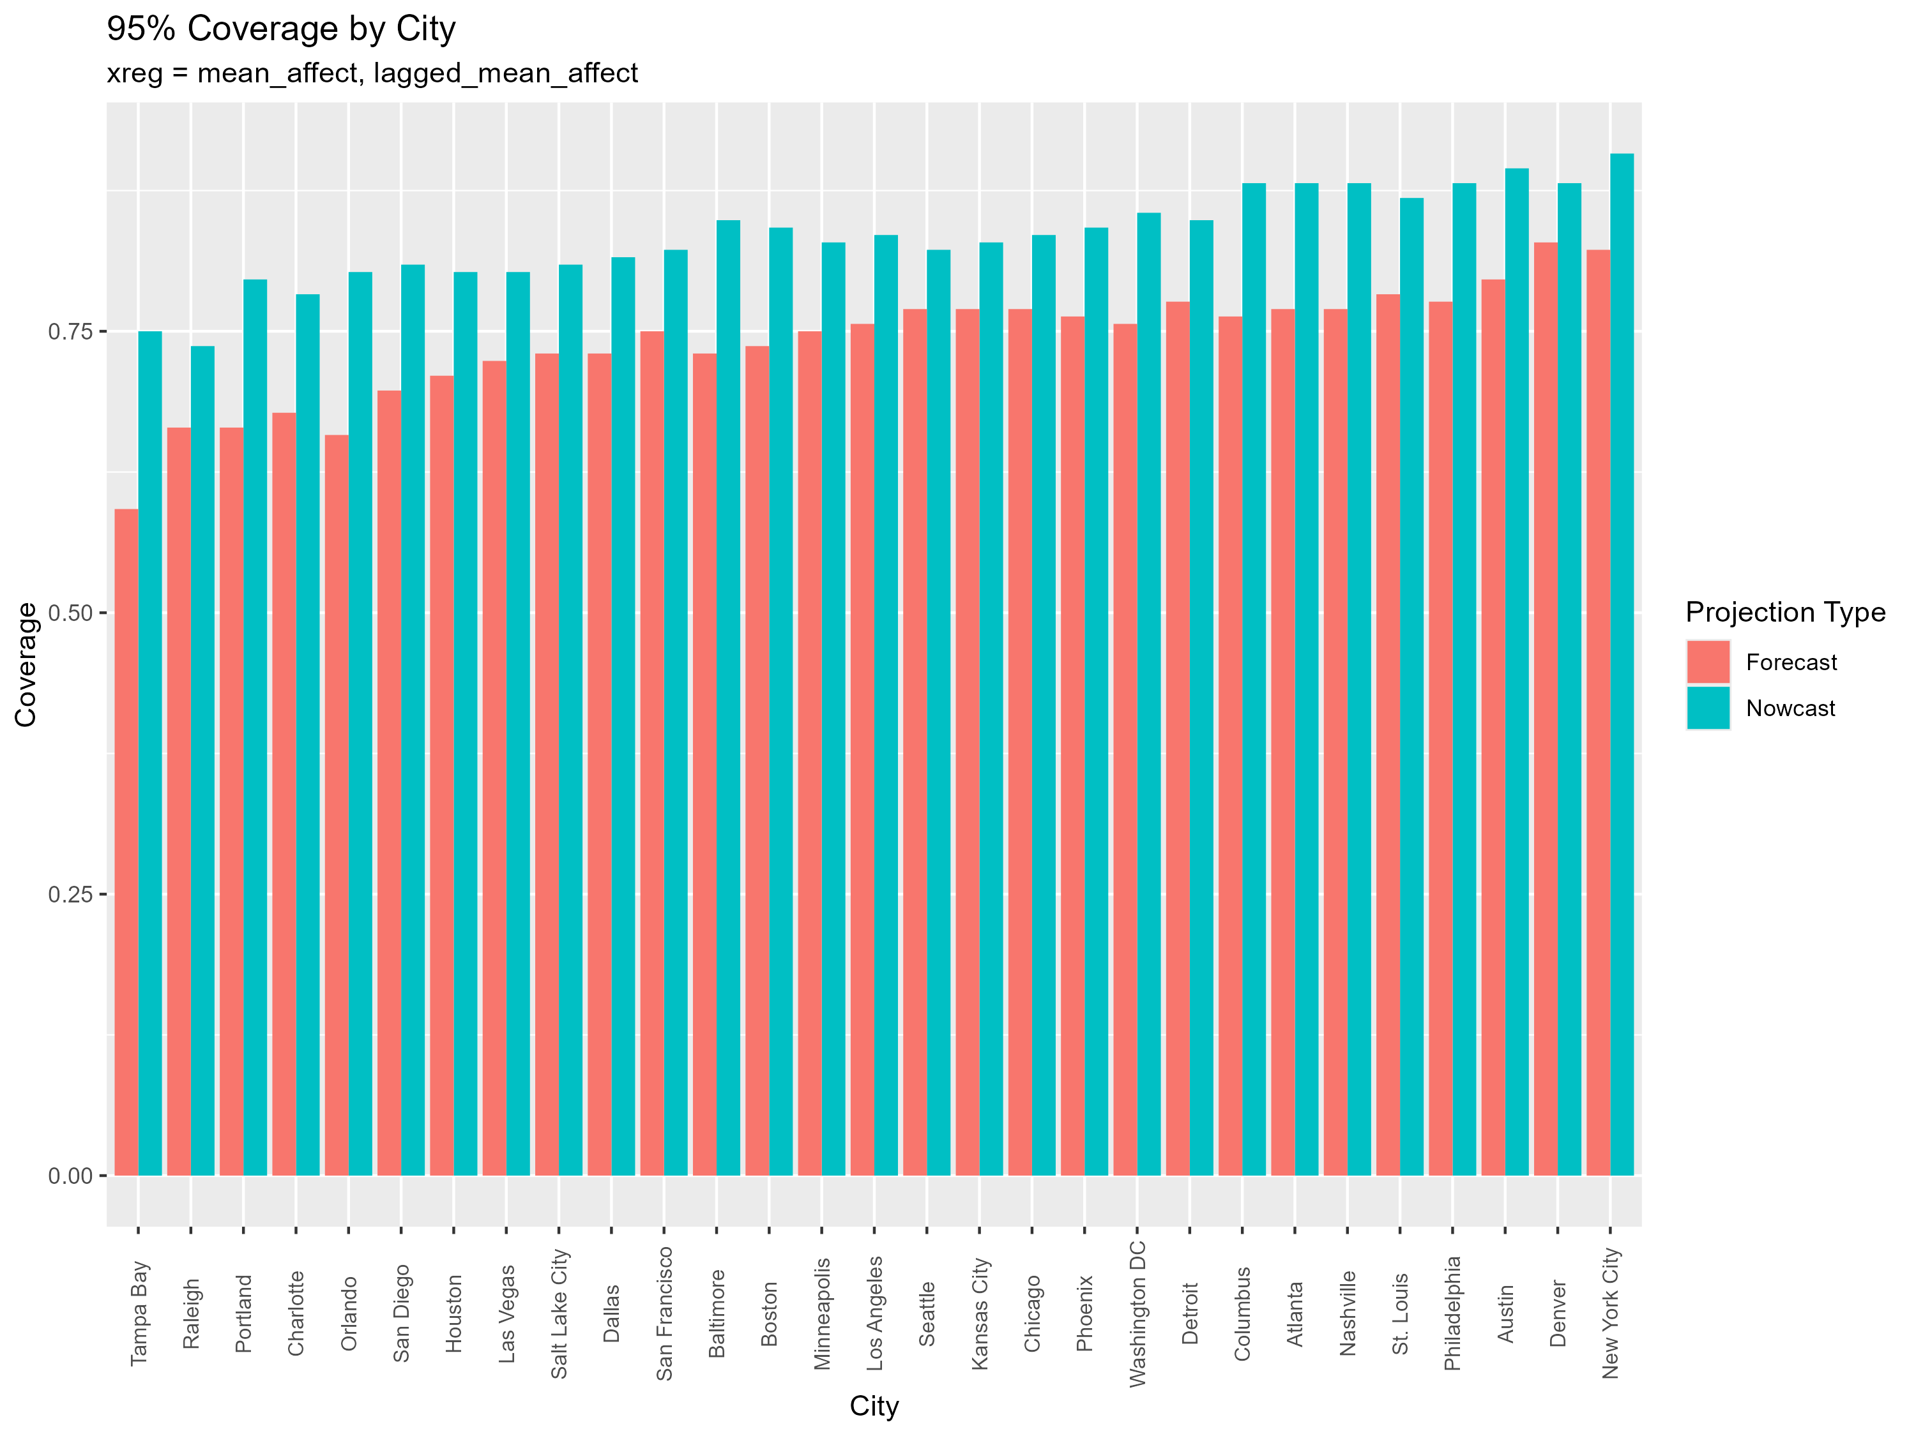

Slide 16
Explanatory = Physical

Slide 17


Slide 18
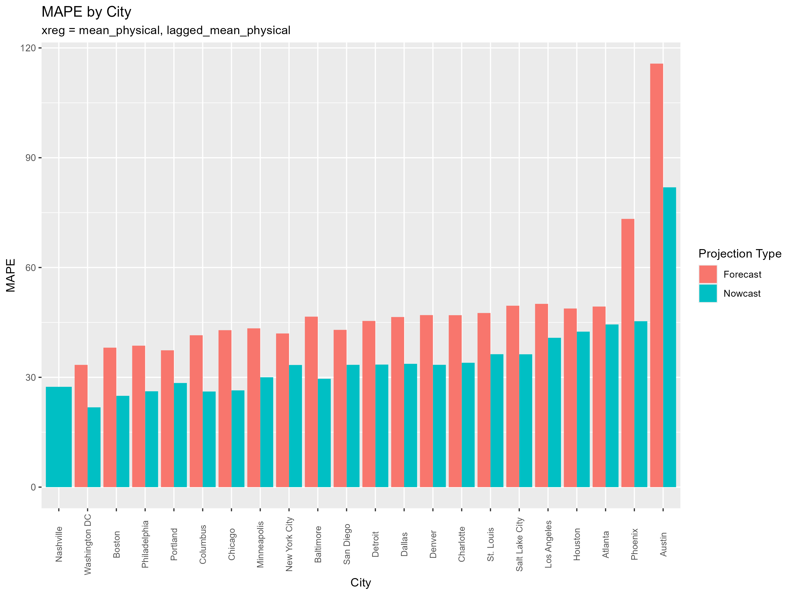

Slide 19
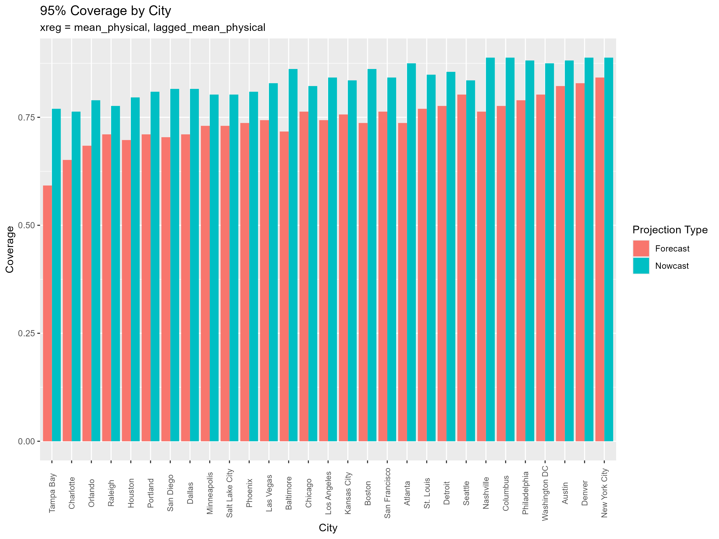

Slide 20
Explanatory = family

Slide 21
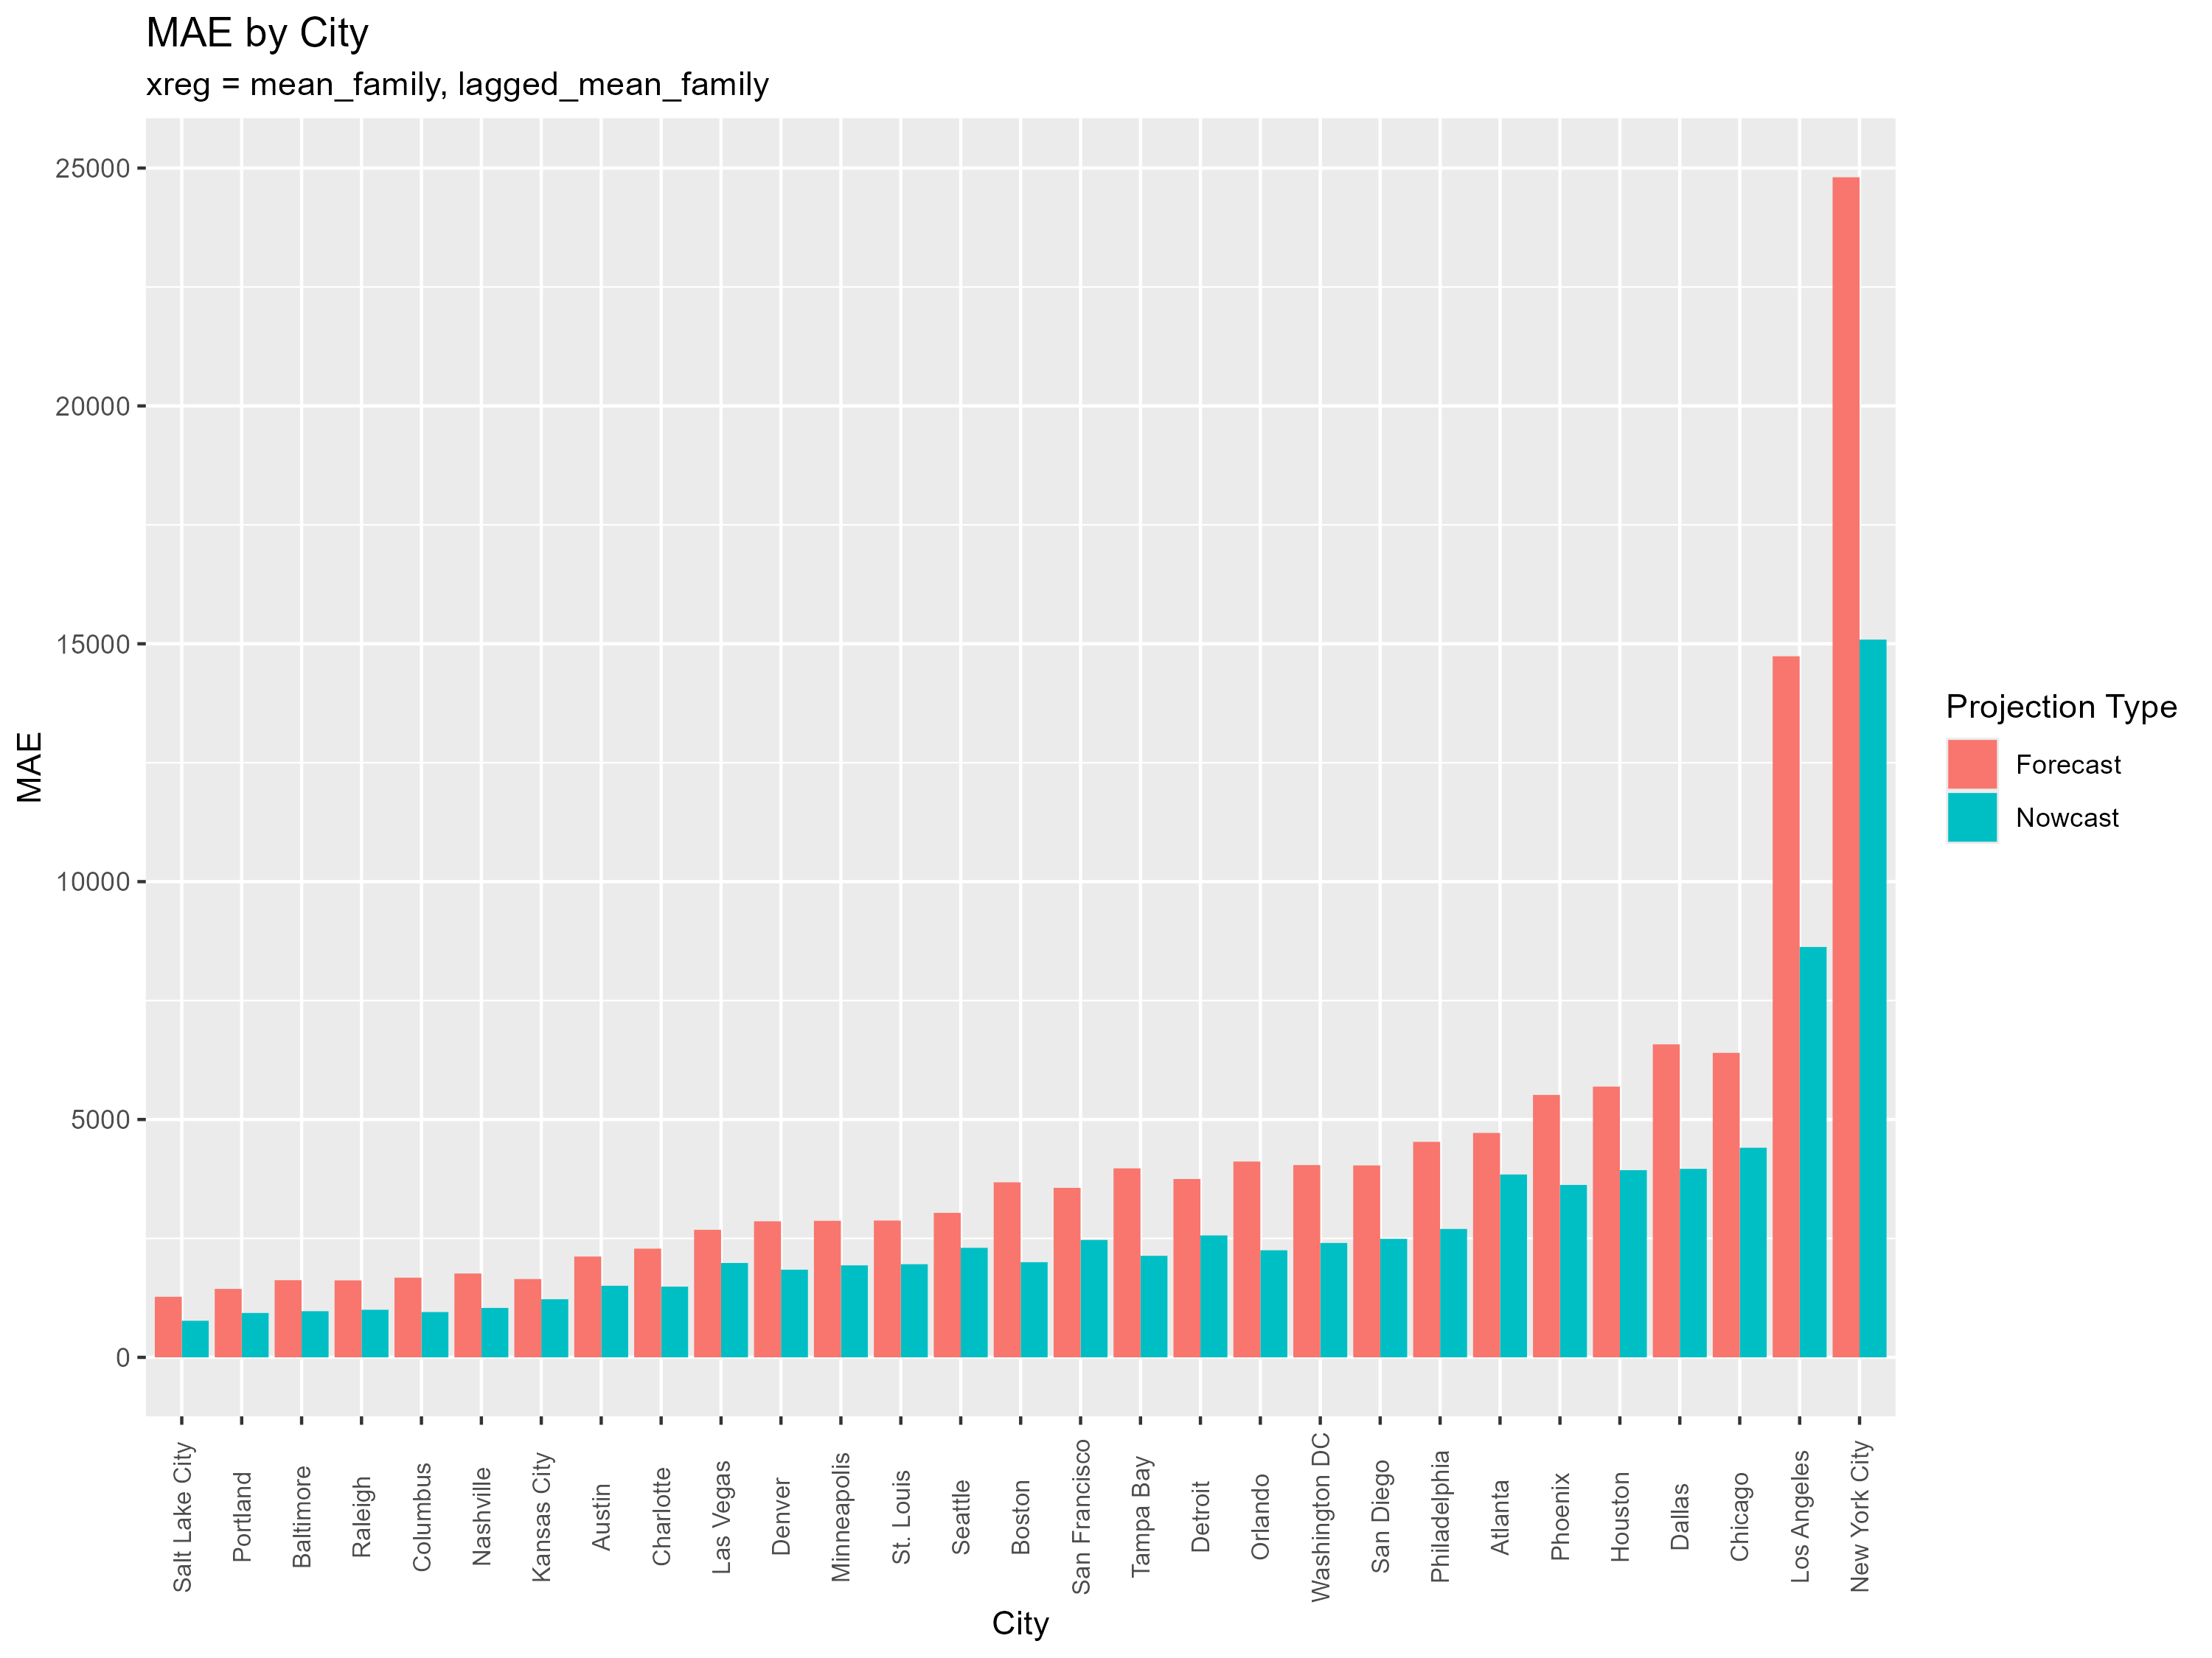

Slide 22
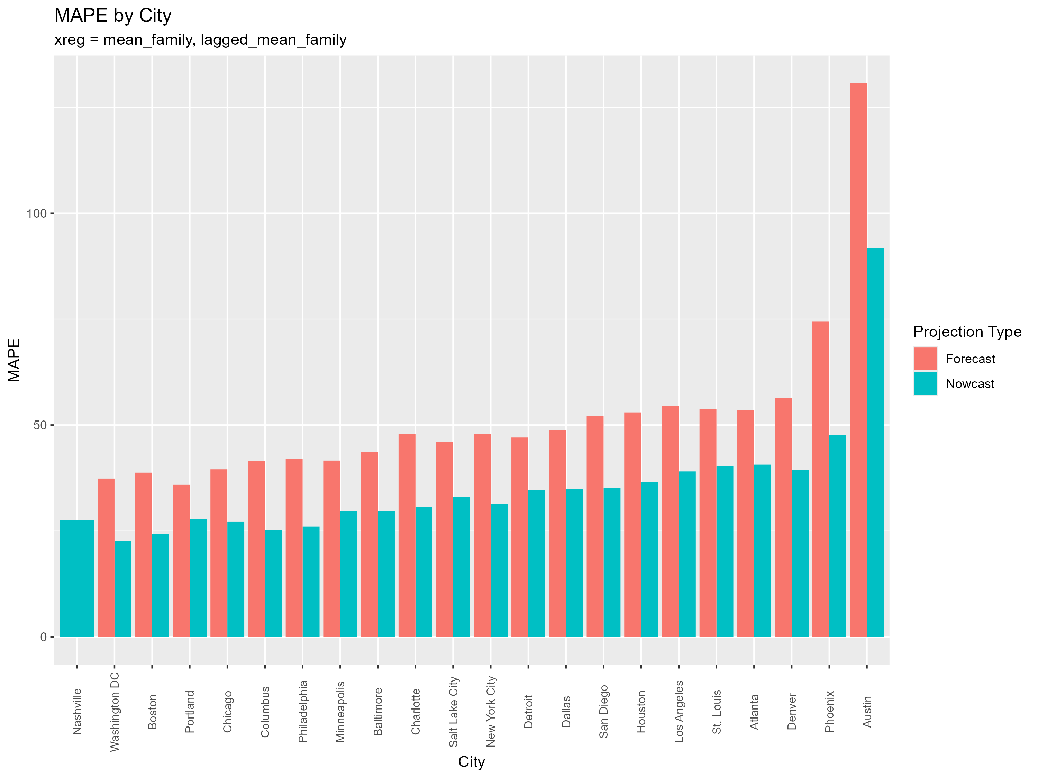

Slide 23


Slide 24
Explanatory = mean_COVID_Related

Slide 25


Slide 26
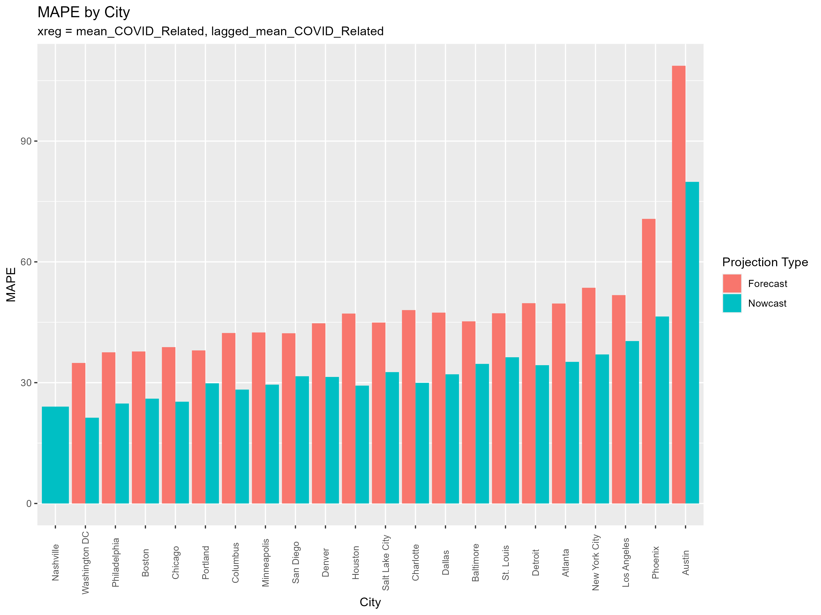

Slide 27
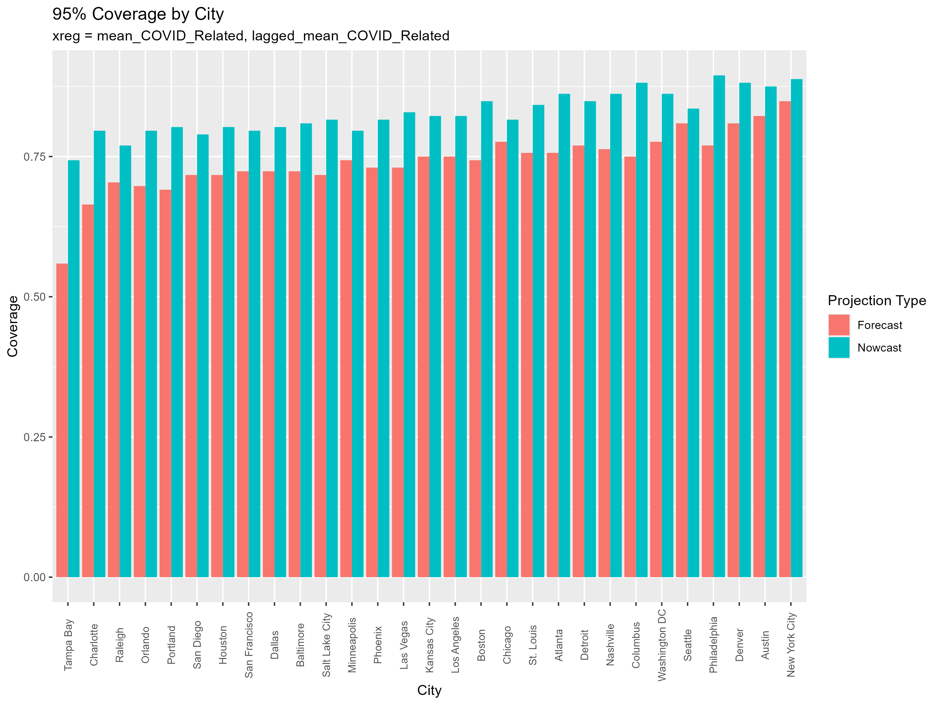

Slide 28
Next Steps
Rajath
Compare performance by xreg (Did using different combinations of Reddit Variables improve performance of the model? Which was the best by MAE, MAPE, etc.)
Performance by population? Are there outliers?
Spencer
Summarize Table of MAE, MAPE, across cities for each indicator (1 for now cast and forecast)
new model
No xreg – no predictors
Calculate summary stats
Compare to predictors

